Slide 1

3D Plotting: Rayshader and World Maps
Maxwell Reikosky
Comp Tools for Social Science
Fall 2020

Slide 2
Project Goals
Create 3D geographic models showing:
Migration and displacement by country;
Climate vulnerability by country

Slide 3
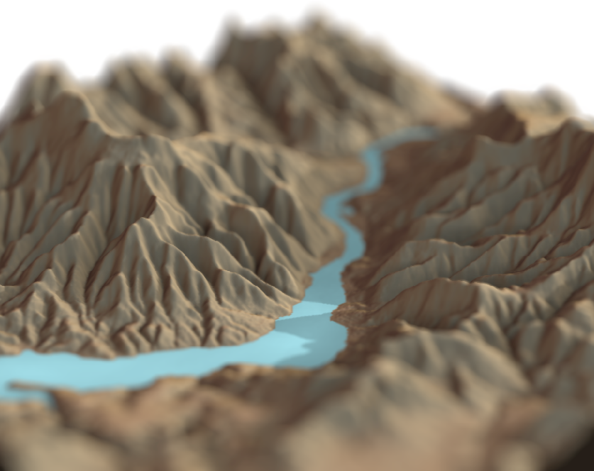
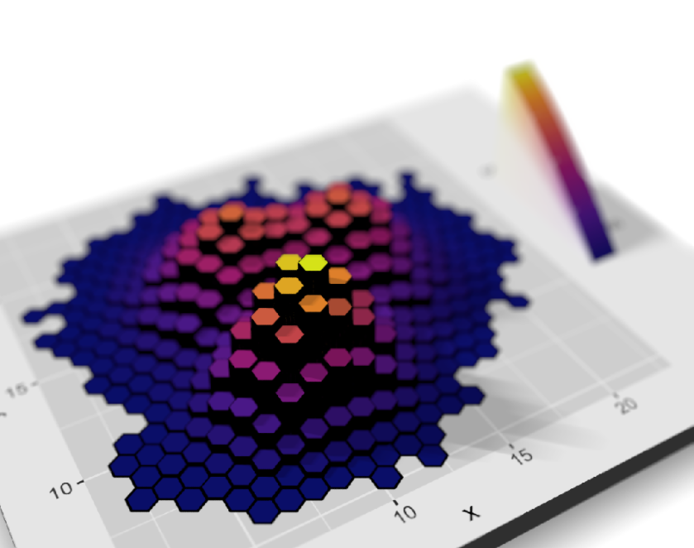
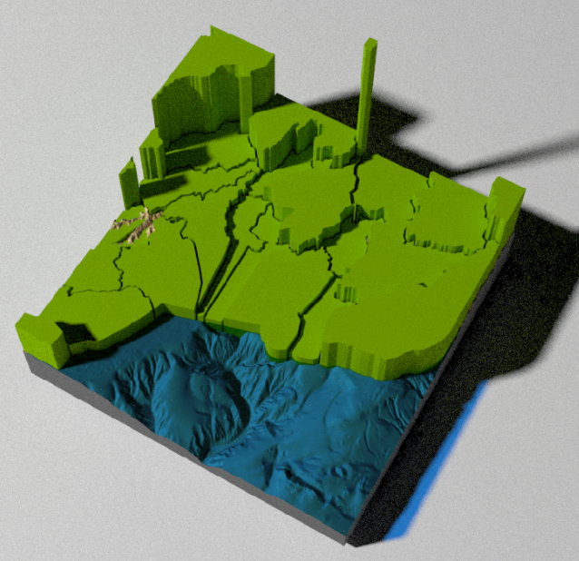
Rayshader

Slide 4
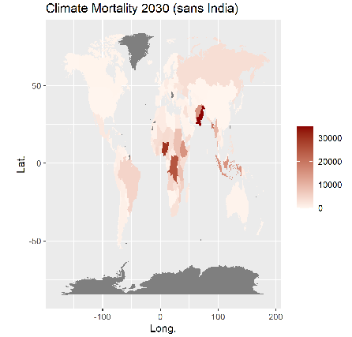
Steps
Install packages/devtools
Import, clean, merge data sets:
Refugee Population by Country 2019 – World Bank
Climate Mortality by country 2030 – Dank
World Map (available in R)
3. Ggplot in 2D
4. Rayshader (plot_gg) in 3D

Slide 5
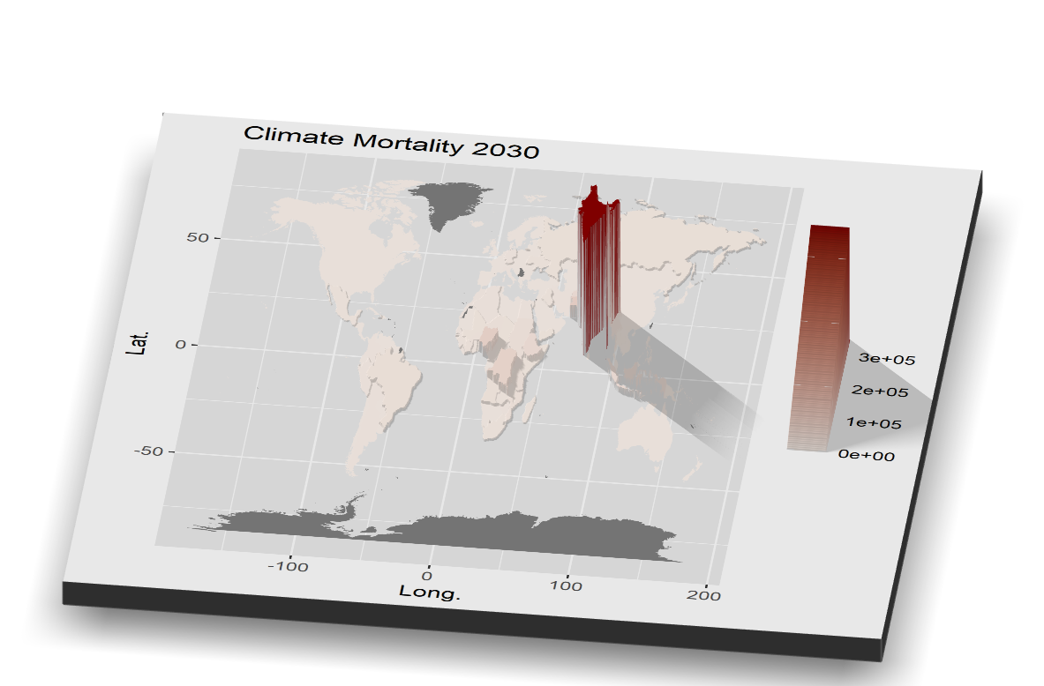
Steps

Slide 6
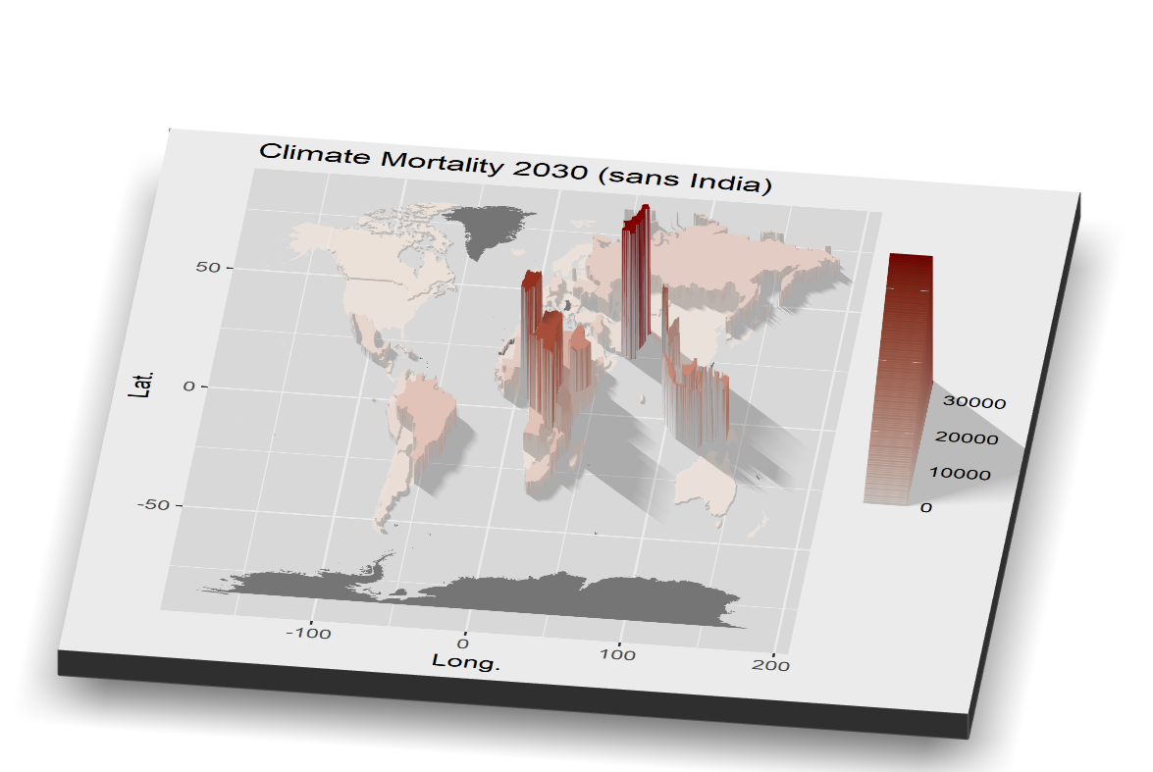

Slide 7
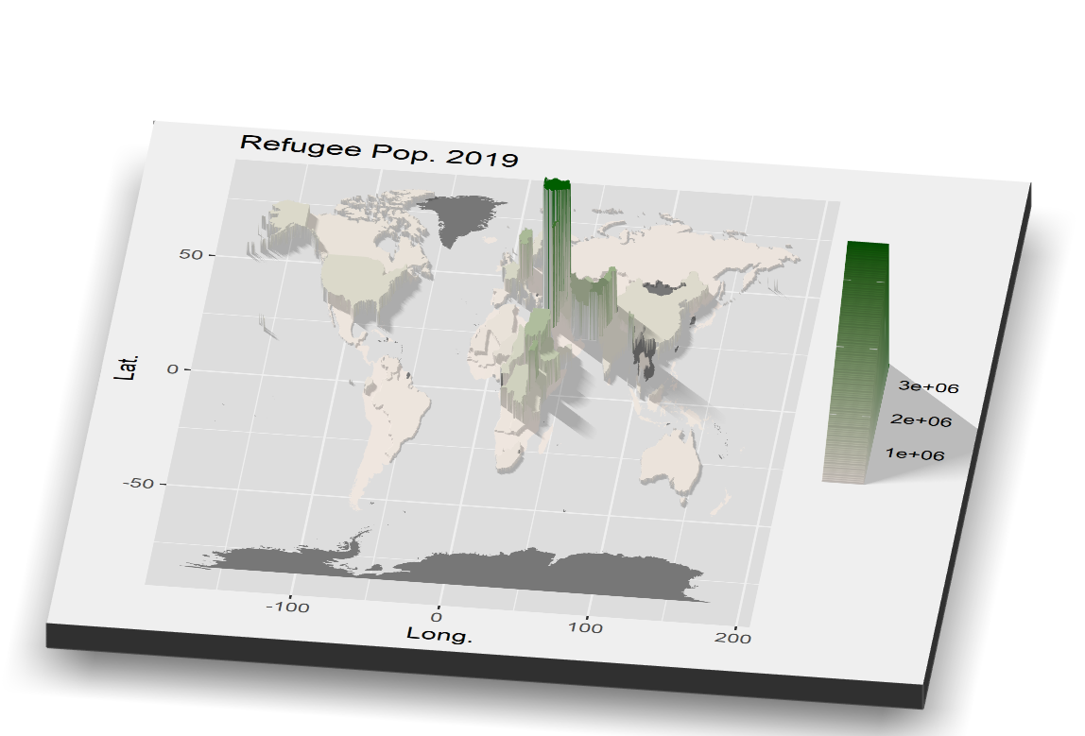

Slide 8
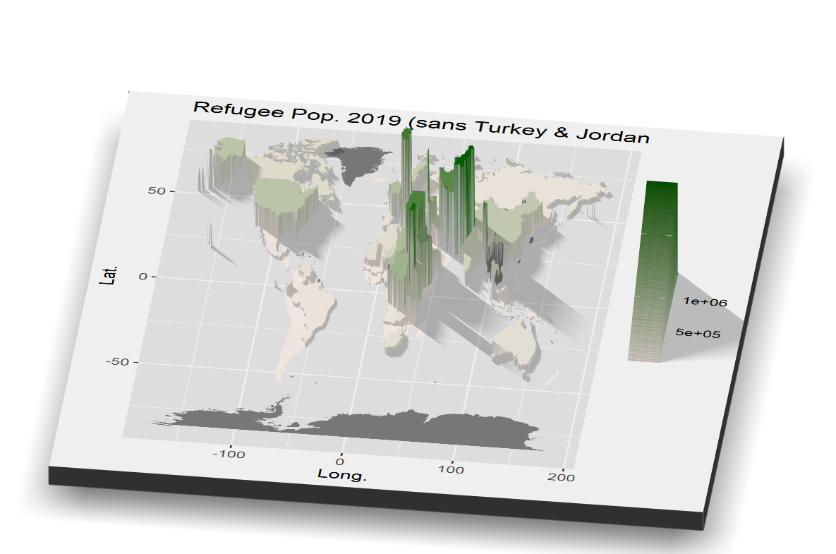

Slide 9
Pros
Looks pretty
3D effect for spatial data
3. Lots of options
(map upload, texture, shadow, gifs)

Slide 10
Cons
Scarce online literature
2. Less options with ggplot
(no gifs?)
3. Knitting error ☹

Slide 11
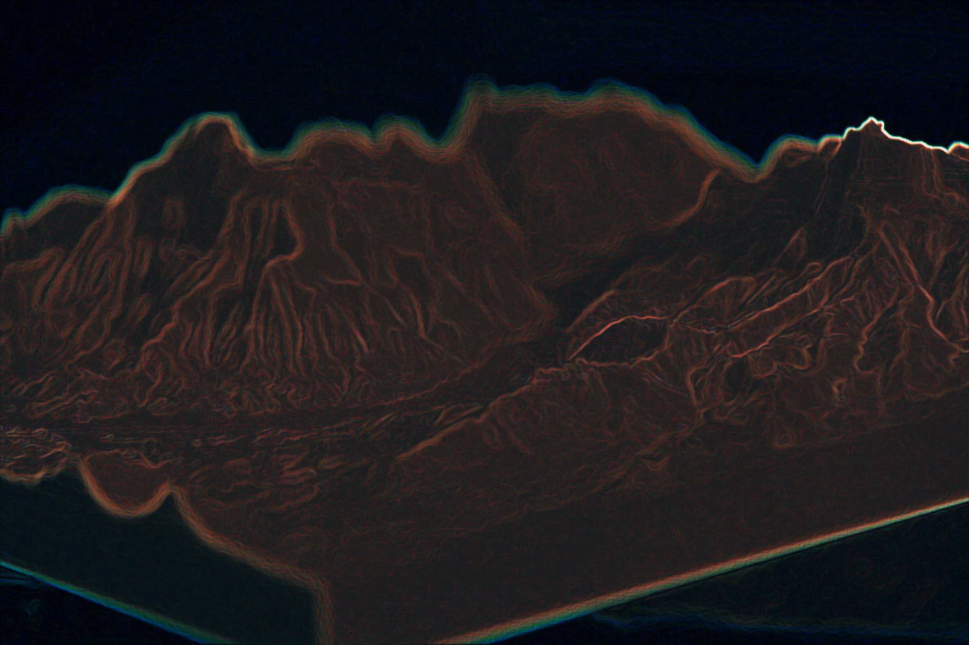
THANK YOU

